Slide 1



SOCIAL MEDIA ANALYTICS
IN TALENT ACQUISITION
A Case Study of Jazz Pakistan
Prepared By: M. Sulaiman (SP25-BDA-004) & Shafqat Rehman (SP25-BDA-010)
Instructor: Dr Zohra Saleem Date: 21/11/2025
COMSATS UNIVERSITY ISLAMABAD, ABBOTTABAD CAMPUS

Slide 2


The Recruitment Revolution
Traditional
Modern
•
Reactive filling of open positions
•
Proactive engagement (Passive candidates)
•
Reliance on newspaper ads
•
Social Media & Digital Platforms
•
Intuition-based decision making
•
Data-Driven analytics
•
Limited reach & high cost
•
91% employers use social media
Impact: 20% Cost Reduction | 11% Faster Hiring

Slide 3
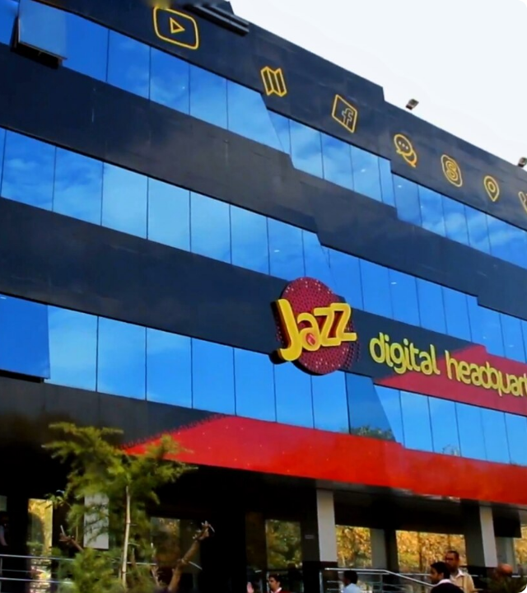
Jazz Pakistan Overview
Pakistan's #1 Digital Operator
Founded in 1994, Jazz has evolved from a mobile operator to a digital powerhouse.
13,000+
Employees
72 Million
Customers
$1.24 Billion
Annual Revenue

Slide 4





Research Objectives
HOW?
WHAT?
BENEFITS?
How does Jazz utilize social media channels like LinkedIn and Facebook for recruitment?
What technology systems (ATS, HCM) does Jazz use for hiring and tracking?
What tangible benefits and competitive advantages does Jazz achieve?

Slide 5



Theoretical Framework
Technology Acceptance Model (TAM)
Resource-Based View (RBV)
How to sustain competitive advantage?
Why do employees adopt new tools?
Valuable (Improves Efficiency)
Perceived Usefulness
+
Rare (Advanced Analytics)
Inimitable (Integrated Process)
Perceived Ease of Use
Non-substitutable
User Adoption

Slide 6
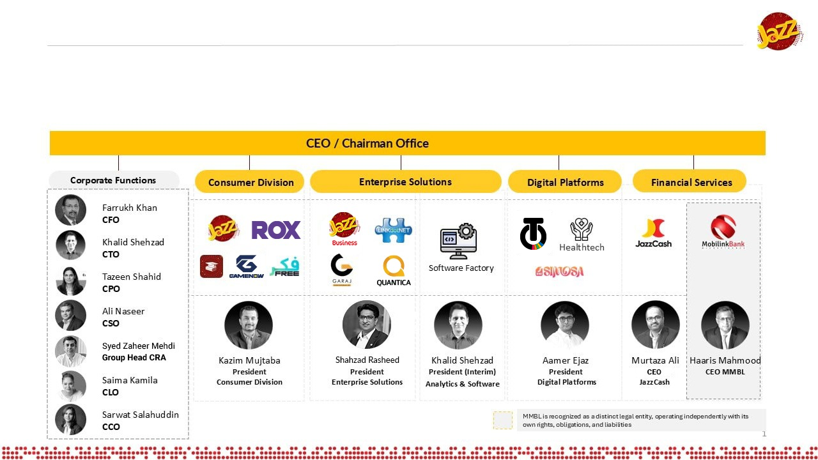
LinkedIn Strategy: Professional Reach
900M+ Users: Primary channel for professional, technical, and senior roles.
Passive Candidates: Reaches qualified talent not actively looking for jobs.
Employer Branding: Thought leadership articles and company achievements.
Employee Spotlights: Humanizing the brand through employee success stories.

Slide 7
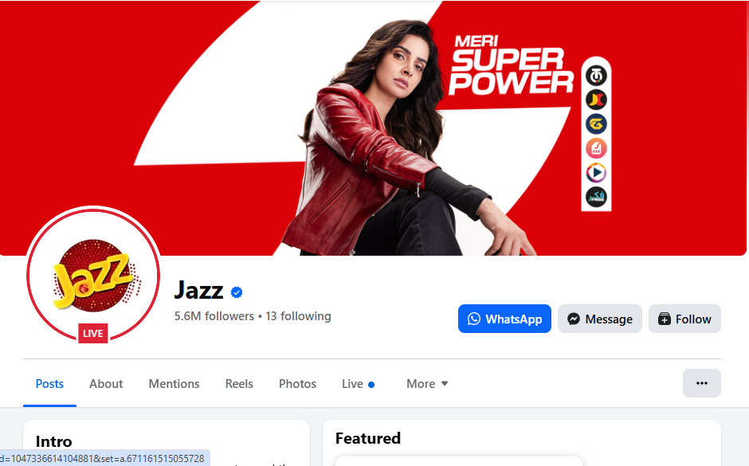
Facebook Strategy: Cultural Alignment
Broader Demographic: Targets fresh graduates, interns, and early-career professionals.
Workplace Culture: Showcases "Life at Jazz," events, and diversity initiatives.
75% Statistic: Job seekers research company values/culture on social media before applying.
Cost-Effective: High volume sourcing for entry-level positions.

Slide 8






Workable: Core ATS Engine
Multi-Channel
Resume Parsing
Pipeline
Analytics
One-click posting to LinkedIn, Facebook, and job boards.
Automated data extraction for standardized profiles.
Visual tracking of candidates from application to offer.
Real-time dashboards for time-to-hire and source tracking.

Slide 9


SAP SuccessFactors
Enterprise HR Management
Comprehensive HCM system managing the lifecycle of 13,000+ employees.
Payroll & Benefits
Performance Management
Learning & Development
Seamless integration with Workable

Slide 10
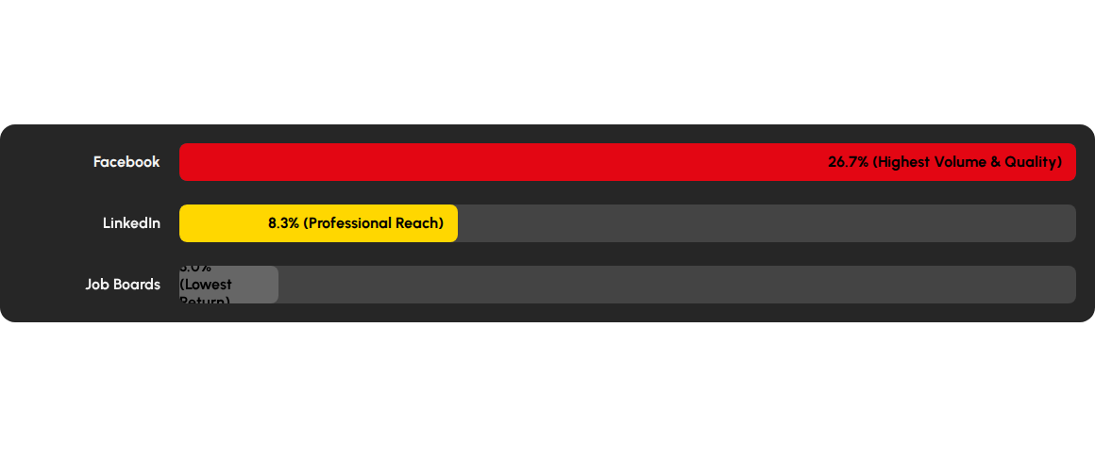
Data-Driven Source Effectiveness
Comparison of Applicant Conversion Rates (Application-to-Interview/Hire)
Insight: **Facebook** delivers the highest conversion rate. Data allows Jazz to allocate budget to high-performing channels. (Raw applicant counts were not specified in the assignment source.)

Slide 11



System Integration Ecosystem
Seamless Data Flow
1. Recruitment (Workable)
Sourcing, Interviewing, Offer Management
2. Lifecycle (SAP SuccessFactors)
Onboarding, Payroll, Performance

Slide 12



Benefits & Key Results
Efficiency
Quality
Strategic
Faster time-to-fill and reduced cost-per-hire through automation and targeted spending.
Better candidate matches, reduced bias via structured scoring, and data-driven sourcing.
Strengthened employer brand, proactive workforce planning, and competitive advantage.

Slide 13
Key Findings
Integrated Approach Wins: The ecosystem of Workable + Social Media + SAP creates a superior hiring engine.
Technology Adoption: Systems were adopted because they were both Useful and Easy to Use (TAM).
Competitive Advantage: Jazz's analytics capability is Valuable, Rare, and Inimitable (RBV).
Social Media is Strategic: It's not just for posting jobs; it's for branding and reaching passive talent.
Data Transforms Recruitment: Moves HR from intuition-based admin to evidence-based strategy.

Slide 14


Conclusion
"Social Media + Analytics = Future of HR"
Jazz demonstrates that strategic investment in HR technology is not a luxury, but a business necessity for competitive advantage.
Thank You
Questions?

